Slide 1
SBA Economic Injury Disaster Loans

Slide 2
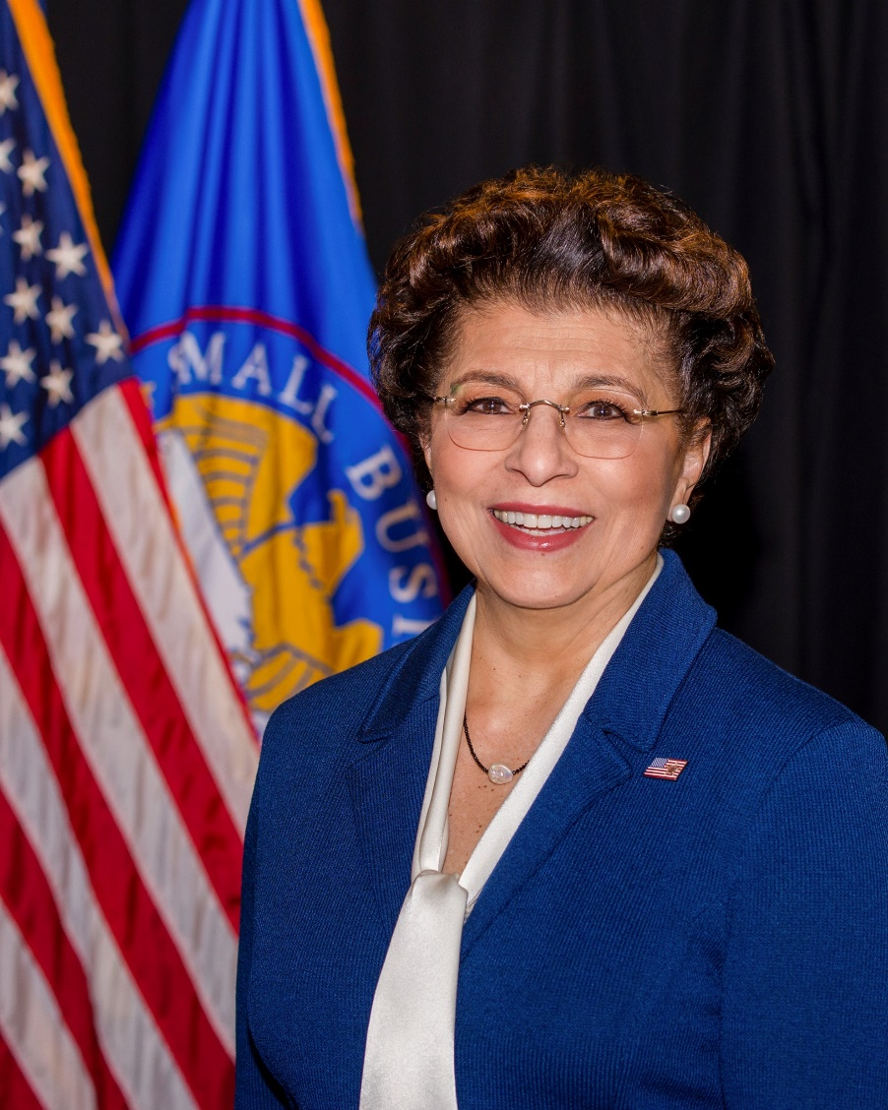
SBA’s Disaster Declaration Makes Loans Available Due to the Coronavirus (COVID-19)
The U.S. Small Business Administration (SBA) is offering designated states and territories low-interest federal disaster loans for working capital to small businesses suffering substantial economic injury as a result of the Coronavirus (COVID-19).
Administrator Jovita Carranza

Slide 3
SBA’s Working Capital Loans are Different from Other SBA Loans
SBA’s Economic Injury Disaster Loan (EIDLs) funds come directly from the U.S. Treasury.
Applicants do not go through a bank to apply. Instead apply directly to SBA’s Disaster Assistance Program at: DisasterLoan.sba.gov
There is no cost to apply.
There is no obligation to take the loan if offered.
The maximum unsecured loan amount is $25,000.
Applicants can have an existing SBA Disaster Loan and still qualify for an EIDL for this disaster, but the loans cannot be consolidated.

Slide 4
Economic Injury Disaster Loan Eligibility
Am I eligible to apply?
SBA’s Economic Injury Disaster Loans (or working capital loans) are available to small businesses, small agricultural cooperatives, small aquaculture businesses and most private non-profit organizations
This includes:
Businesses directly affected by the disaster
Businesses that offer services directly related to the businesses in the declaration
Other businesses indirectly related to the industry that are likely to be harmed by losses in their community
(Example: Manufacturer of widgets may be eligible as well as the wholesaler and retailer of the product.)
4

Slide 5
Small Business Eligibility
What kinds of small businesses can apply?
Examples of eligible industries include but are not limited to the following:
Restaurants, retailers, manufacturers, sports vendors, owners of rental property, souvenir shops, travel agencies, hotels, recreational facilities, charter boats, wholesalers, etc.
How do I know if I am “small business”?
Visit: https://www.sba.gov/document/support--table-size-standards
5

Slide 6
Private Non-Profit Eligibility
What kinds of non-profits may apply?
Nursing homes, food kitchens, museums, educational facilities, senior citizen centers, daycare centers, playhouses, community centers, shelters, rescue organizations, associations, etc.
An eligible private non-profit organization is a non-governmental agency or entity that currently has:
(1) An effective ruling letter from the U.S. Internal Revenue Service, granting tax exemption under sections 501(c), (d), or (e) of the Internal Revenue Code of 1954
OR
(2) Satisfactory evidence from the State that the non-revenue producing organization or entity is a non-profit one organized or doing business under State law.
6

Slide 7
Ineligible Entities
What are some of the businesses that are ineligible for an Economic Injury Disaster Loan?
Agricultural Enterprises -If the primary activity of the business (including its affiliates) is as defined in Section 18(b)(1) of the Small Business Act, neither the business nor its affiliates are eligible for EIDL assistance. Please contact USDA or the State of Minnesota for agriculture-related assistance.
Religious or Charitable Organizations and government-owned concerns
Businesses considered hobbies
Gambling Concerns - more that 1/3 of annual gross revenue from legal gambling activities
Speculative real estate businesses
7

Slide 8
SBA’s Economic Injury Disaster Loan Terms
How much can I borrow?
Eligible entities may qualify for loans up to $2 million.
The interest rates for this disaster are 3.75 percent for small businesses and 2.75 percent for nonprofit organizations with terms up to 30 years.
Eligibility for these working capital loans are based on the size (must be a small business) and type of business and its financial resources.
How can I use the loan funds?
Fixed debts
Payroll
Accounts payable
Other bills that could have been paid had the disaster not occurred
The loans are not intended to replace lost sales or profits or for expansion.

Slide 9
SBA’s Economic Injury Disaster Loan Terms
What is the criteria for a loan approval?
Credit History
Applicants must have a credit history acceptable to SBA and is assessed in a case by case basis. Repayment
SBA must determine that the applicant business has the ability to repay the SBA loan.
Collateral Requirements
Economic Injury Disaster Loans over $25,000 require collateral.
SBA takes real estate as collateral when it is available.
SBA will not decline a loan for lack of collateral, but requires borrowers to pledge what is available.
9

Slide 10
Preparing to Apply
Gather your documents:
Tax Information Authorization (IRS Form 4506T) for the applicant, principals and affiliates.
Complete copies of the most recent Federal Income Tax Return.
Schedule of Liabilities (SBA Form 2202).
Personal Financial Statement (SBA Form 413) (Other Information may also be requested)
10

Slide 11
Preparing to Apply
Other information that may be requested:
Complete copy, including all schedules, of the most recent Federal income tax return for principals, general partners or managing member, and affiliates (see filing requirements for more information).
If the most recent Federal income tax return has not been filed, a year-end profit-and-loss statement and balance sheet for that tax year .
A current year-to-date profit-and-loss statement .
Additional Filing Requirements (SBA Form 1368) providing monthly sales figures. (This is especially important for Economic Injury Disaster Loans.)
11

Slide 12
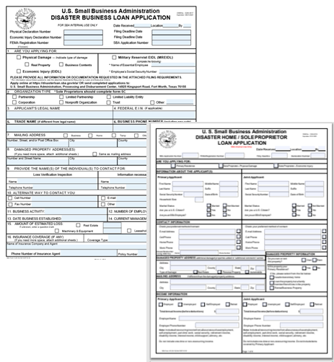
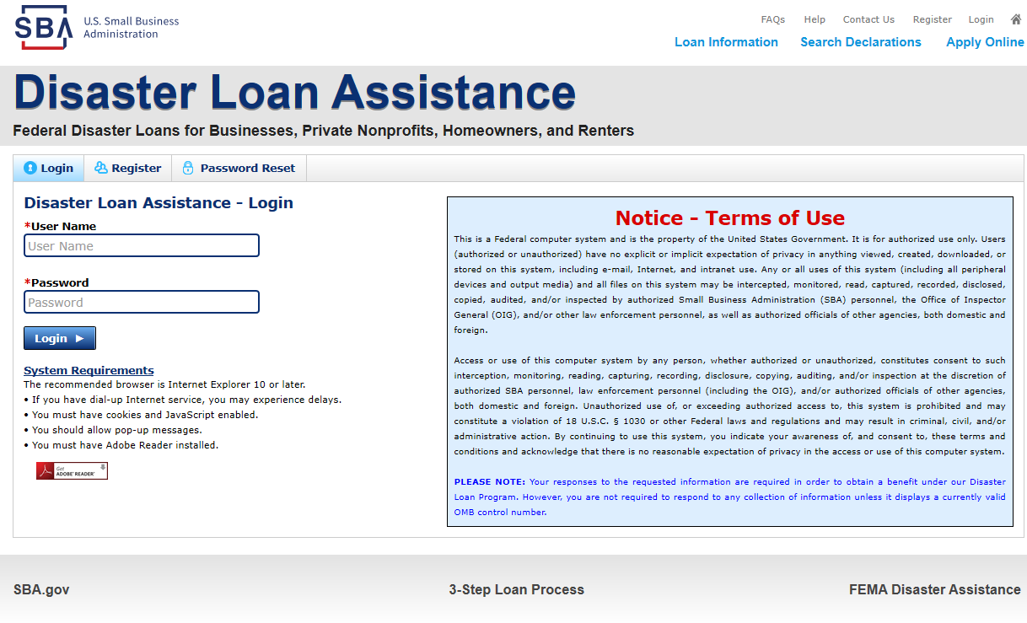
Ready to Apply
1) Have all business/non-profit financial and tax documents on hand
2) Complete the SBA loan application
Hard-copy SBA Form 5 or SBA Form 5C for sole proprietorships
OR Apply online for auto populating SBA forms
TIP: Download the SBA hard-copy forms to prepare for the online form submission and make sure you save your application online as you go!
*Although a paper application and forms are acceptable, filing electronically is easier, faster and more accurate.
12

Slide 13
Options to Apply
Applicants may apply online using the Electronic Loan Application (ELA) via SBA’s secure website at https://disasterloan.sba.gov/ela.
Paper loan applications can be downloaded from the link above. Completed applications should be mailed to:
U.S. Small Business Administration
Processing and Disbursement Center
14925 Kingsport Road, Fort Worth, TX 76155
Disaster loan information and application forms may also be obtained by calling the SBA’s Customer Service Center at 800-659-2955 (800-877-8339 for the deaf and hard-of-hearing) or by sending an email to disastercustomerservice@sba.gov.

Slide 14
Submit Your Application As Soon As Possible
The biggest reason for delays in processing is due to missing information.
Make sure to complete all filing requirements before submitting the application and forms.
Can I change my loan amount once I have submitted an application?
If more funds are needed, applicants can submit supporting documents and a request for an increase.
If less funds are needed, applicants can request a reduction in the loan amount.
What if I am denied a loan?
If the loan request is denied, the applicant will be given up to six months in which to provide new information and submit a written request for reconsideration.

Slide 15
Assistance From SBA Partners
No-cost technical assistance, consulting, and mentorship from any of SBA’s Resource Partners:
Small Business Development Centers (SBDCs)
SCORE
Women’s Business Centers (WBC)
Veteran’s Business Outreach Centers
For the nearest office, visit: https://www.sba.gov/local-assistance
SBA Minnesota District Office
Minneapolis.mn@sba.gov

Slide 16
Any Questions?
More information concerning
SBA and its programs
Twila Kennedy, Lead Economic Development
twila.kennedy@sba.gov | 612.370.2300

